Slide 1
Math Emergency Plan
June 2, 2008

Slide 2
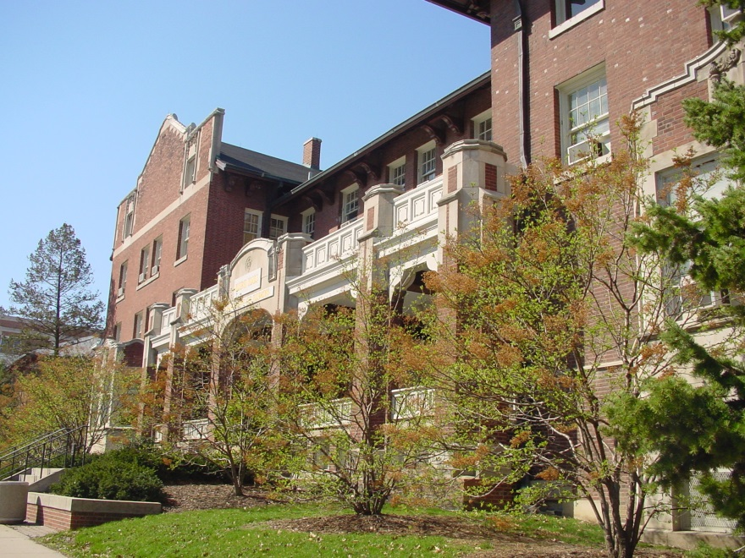
Do you know?
Where is the closest exit from this room?
What exit would most people use in an emergency?
Where is the closest fire extinguisher?
Where is the closest alarm pull?
Notes:
Closest exit from 245AH: exit out and to the left
Exit most people use: the exterior door he/she came in
Closest extinguisher: Right outside the door to 245AH
Closest pull: bottom of the stairs, heading towards the Union

Slide 3
Roles
Instructor/TA
Floor coordinators
Volunteer/assistant to disabled
Emergency management team
Ando, Ahlgren, York, Mullen, Corkery, Bruning
Communications team (as needed)

Slide 4
In case of fire
Listen for instructions
Keep calm
Use nearest exit—see postings in classrooms
If can’t exit, go into room with window, close door, signal help

Slide 5
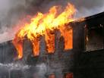
Instructors/TAs: Fire
Know closest exit from room (see charts)
Share procedures with students on day 1
Keep class calm, informed
Guide students to rally point
Assist those with disabilities
Count students once at rally point; inform firefighters if any missing

Slide 6
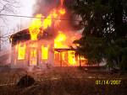
Floor coordinators: Fire
Call 911 if necessary
Inform others on your floor of the need to evacuate
Assist disabled, if possible
Exit the building and join others at the rally point
Share information with firefighters

Slide 7
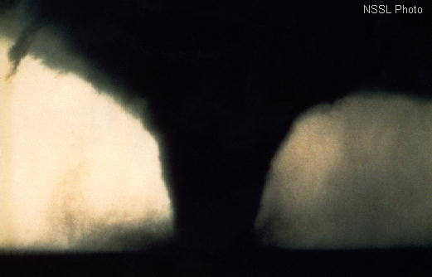
In case of tornado
Listen for instructions
Secure work area and move to lowest level of building
Take cover away from doors and windows, in an interior room if possible
In Altgeld, use east corridor and close doors
Listen for instructions once threat passed

Slide 8
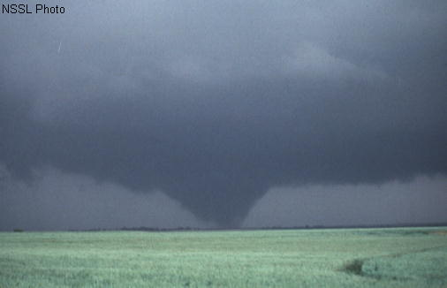
Instructors/TAs: Tornado
Share procedures with students on day 1
Keep class calm, informed
Guide students to safe area
Assist those with disabilities

Slide 9
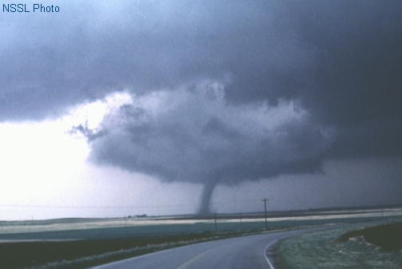
Floor coordinators: Tornado
Receive message from offices with weather radios
Inform others on your floor of the need to move to lowest level
Assist disabled, if possible
Inform others when conditions are clear

Slide 10
In case of active threat
Listen/watch for updates
Evacuate if safe to do so
Seek safe refuge behind closed door, closed windows; barricade
Provide simple first aid (ie. pressure and elevation to wound) if necessary
Do not contact individual posing threat
unless absolutely necessary

Slide 11
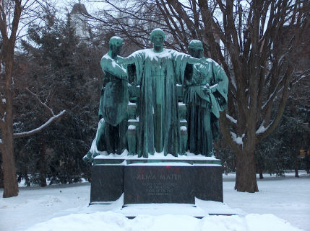
Active threat, cont’d
Plan how to combat if necessary/desired
Open doors only for Police
Do not approach Police during threat situation
Be aware that the response to the situation is an individual decision

Slide 12
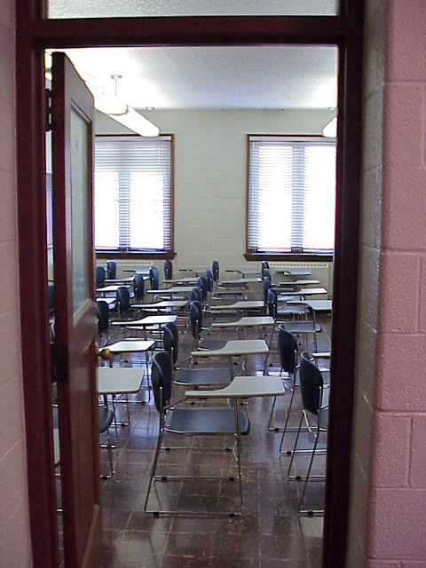
Instructors/TAs: Active threat
Share procedures with students on day 1
Keep class calm, informed
Close and stay away from door/windows
Plan as a group how to handle possible attack
Open door for Police only
Response to the situation
is an individual decision

Slide 13
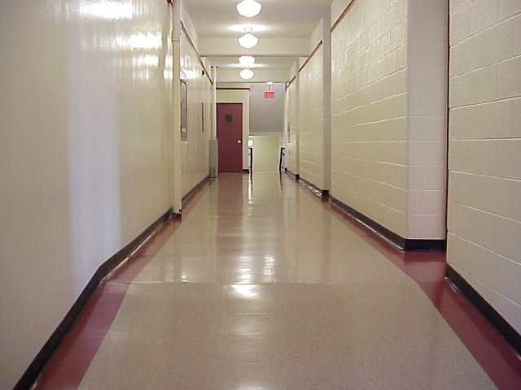
Floor coordinators: active threat
Call 911 if not yet done
If possible, warn others on floor, including commons areas
Evacuate or seek safe refuge

Slide 14
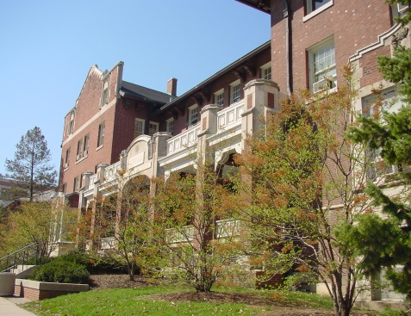
For more information…
Office of Campus Emergency Planning
www.ocep.uiuc.edu
UI Division of Public Safety
www.dps.uiuc.edu
Champaign Police
www.ci.champaign.il.us/public_safety/pspl.php
Urbana Police
www.ci.urbana.il.us/

